Slide 1
DISTRIBUTIONS: OVERVIEW
Types of variables
Discrete variable: only takes on specific values
Continuous variable: can be any value within a range
Much atmospheric data!
Probability distribution: associated with a mathematical function ~ capturing the variation of a group of data called the
probability density function (continuous var)
probability mass function (discrete var)

Slide 2
DISTRIBUTIONS: OVERVIEW
Interpretation:
PDF: integrating the PDF between two values = the probability that a random data point would fall between the two values
PMF: PMF at a given value = the probability that a random data point would be that value
Why use a distribution?
Allows for
Compactness
Smoothing
Extrapolation

Slide 3
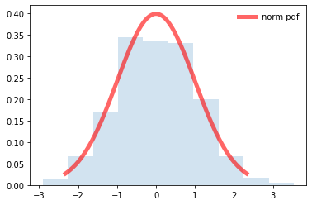
CONTINUOUS DISTRIBUTIONS: NORMAL
Normal distribution: also known as “Gaussian distribution”
Recall: “bell-shaped” curve – symmetrical
Central Limit Theorem: as # of data points gets large, taking the sum or the mean of an independent set of data points, and doing this for different groups = Gaussian sampling distribution
Regardless of the original distribution of the data points!
Allows broader applicability of Gaussian distributions in meteorology and other sciences!

Slide 4
CONTINUOUS DISTRIBUTIONS: NORMAL
Parameters: mean, standard deviation
Physical examples:
Average monthly temperatures
Heights of people!

Slide 5
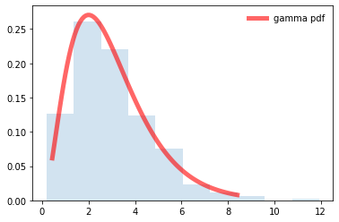
CONTINUOUS DISTRIBUTIONS: GAMMA
Gamma distribution: well-suited for data that is asymmetrical and skewed to the right, physically bound on low-end (by 0)
Parameters: shape, scale
Physical examples:
Wind speed
Precipitation
Rain drop size distribution – special version called exponential distribution
Population dynamics

Slide 6
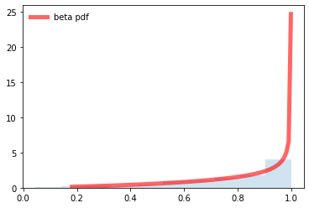
CONTINUOUS DISTRIBUTIONS: BETA
Beta distribution: well-suited for data that is bound on both ends – e.g., ranging from 0 to 1
Parameters: two shape parameters
Physical examples:
Rock/mineral properties (ratios)
Soil properties
Cloud cover
Relative humidity
Plant cover
Probabilistic forecasts
Reminder: you have to integrate the probability density function between two values to obtain the probability that a random variable falls between those two values!

